Slide 1
FINAL MID-TERM ASSIGNMENT

Slide 2
Audience
Who will visit my site
My site will be my portfolio site
Many types of people will view it including:
Fellow classmates
Fellow employees and
Potential clients and/or employers

Slide 3
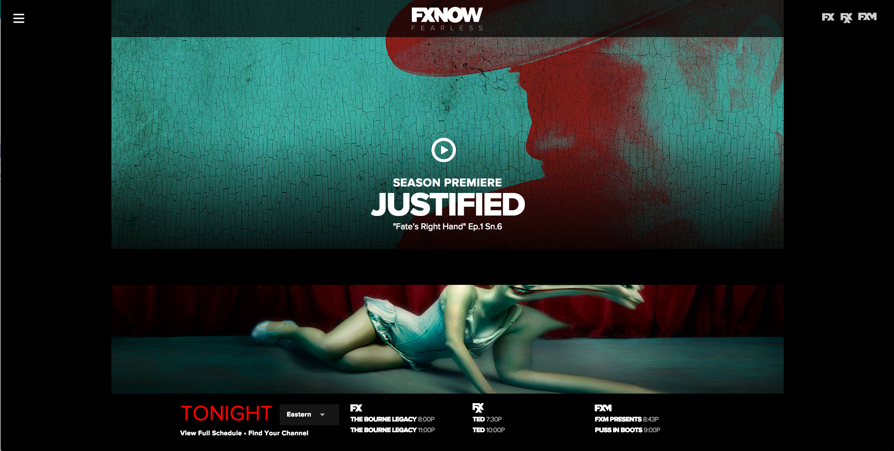
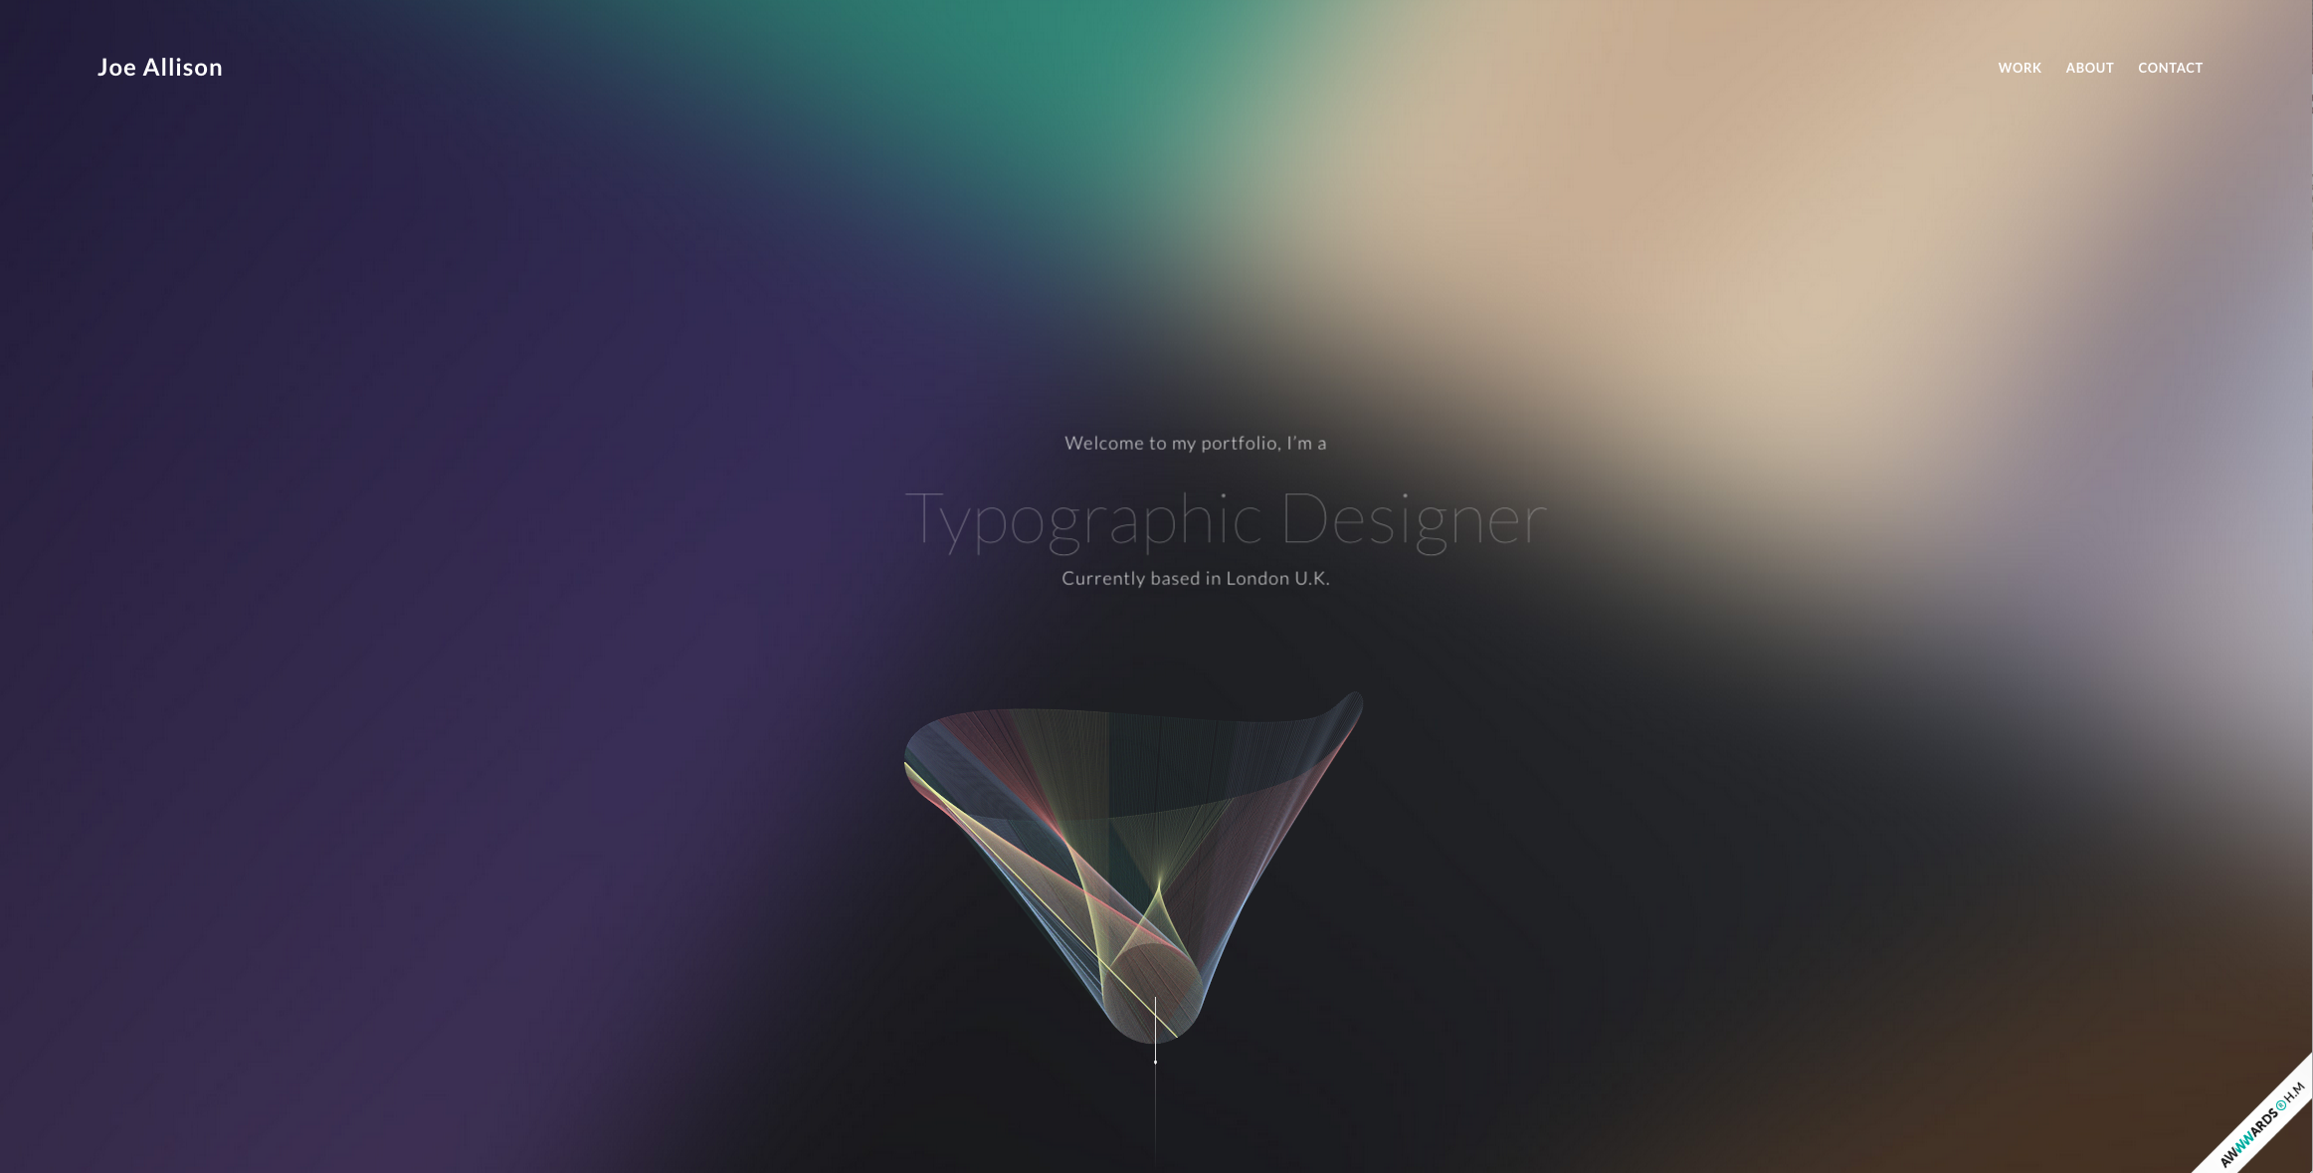
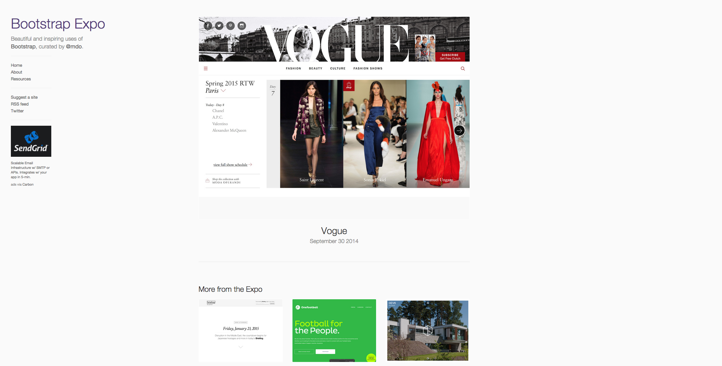
Inspiration
www.fxnetworks.com
http://www.joeallison.co.uk/
http://expo.getbootstrap.com/2014/09/30/vogue/

Slide 4
Parts of my design I’m most proud of:
So Far:
I’m very proud of my logo
I worked very hard on it and went through numerous iterations choosing many fonts and colors before finally landing on the current one
I like my simple color scheme. I don’t think I’ll make many more changes to it
Also like my background choice and social media icons. The background pic is beautiful and warm (orange) and calming with the subdued blues

Slide 5
My Struggles & Overcoming them
Struggles
Overcame
I believe my struggles were split pretty evenly between my asset choices throughout and my understanding of the CSS
Through more use and practice I think my speed will increase and I will be able to build quicker designs with hopefully no struggle on the CSS and indecisiveness
After every conversation with Sarah I feel I understood (1) what my issues and struggles where and (2) what I needed to do to fix them
Through my many iterations I was also at least able to overcome my struggles with my logo and its fonts and colors

Slide 6
Lessons Learned
My biggest struggle was the CSS and the floating and clearing elements in particular
Again, through my conversations with Sarah and some light “Google’ing”, I was able to finally grasp the concept of the floating elements floating things horizontally only and the clear property being needed in order not to allow anymore elements to floating around

